Slide 1

Register on the Vitality website NOW!
www.powerofvitality.com
Notes:
Don’t forget, head to powerofvitality.com and click register now to get started immediately!

Slide 2

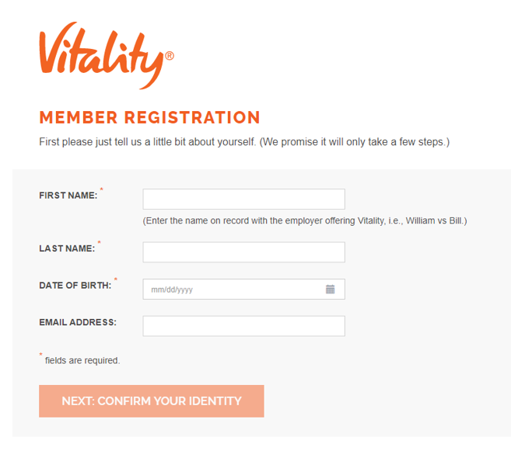
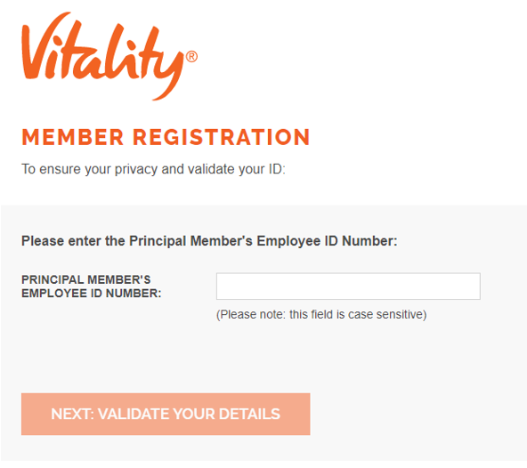
Enter your First Name, Last Name and DOB – then your Employee ID or SSN, depending on what the system asks you for!

Slide 3
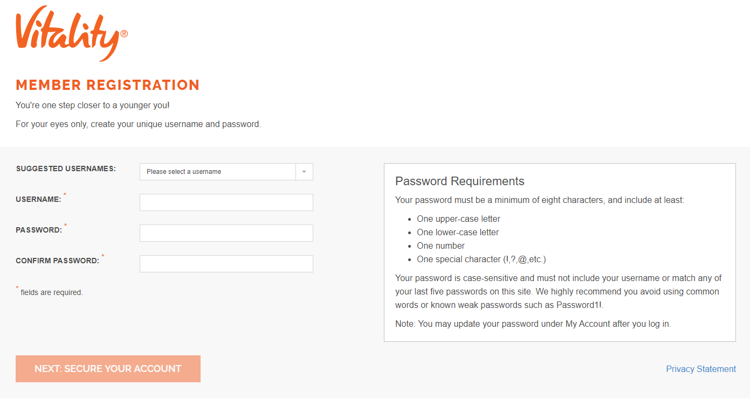
Now, create a username and password.
Feel free to use one of the suggested usernames.
Don’t forget the review the password requirements here!

Slide 4
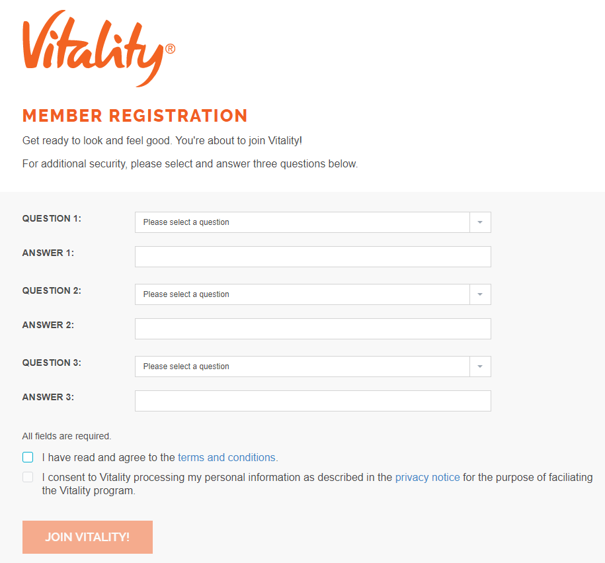
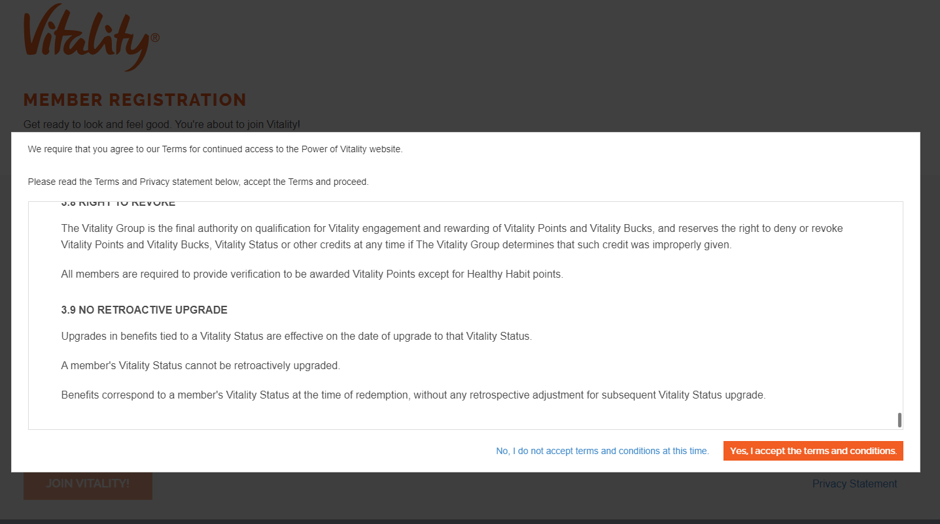
Terms and Conditions will pop up on your screen. Review and scroll to the bottom to “accept” the Terms and Conditions.
Then, create your security questions, read through the privacy notice, and join Vitality!

Slide 5

Reach out for extra assistance
Vitality Customer Care
877.224.7117
Fax: 877.224.7110
Hours: 8:00 a.m. – 5:00 p.m. (CST)
Monday - Friday
email: wellness@powerofvitality.com
Notes:
If you ever have any questions, need extra assistance or need to contact Vitality for any other reason and cannot find the help you need through the Guide to Vitality, the best way to do so is by calling the number on the screen here. You can also email the customer care representatives, but calling is a much quicker way to resolve issues as they can troubleshoot on the spot! Please note: the customer care line is available M-F 8am-5pm Central Standard Time.

